Slide 1
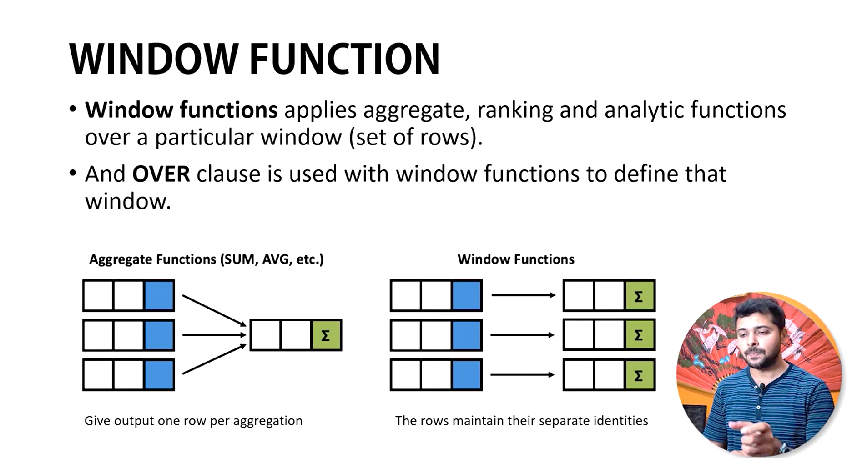

Slide 2
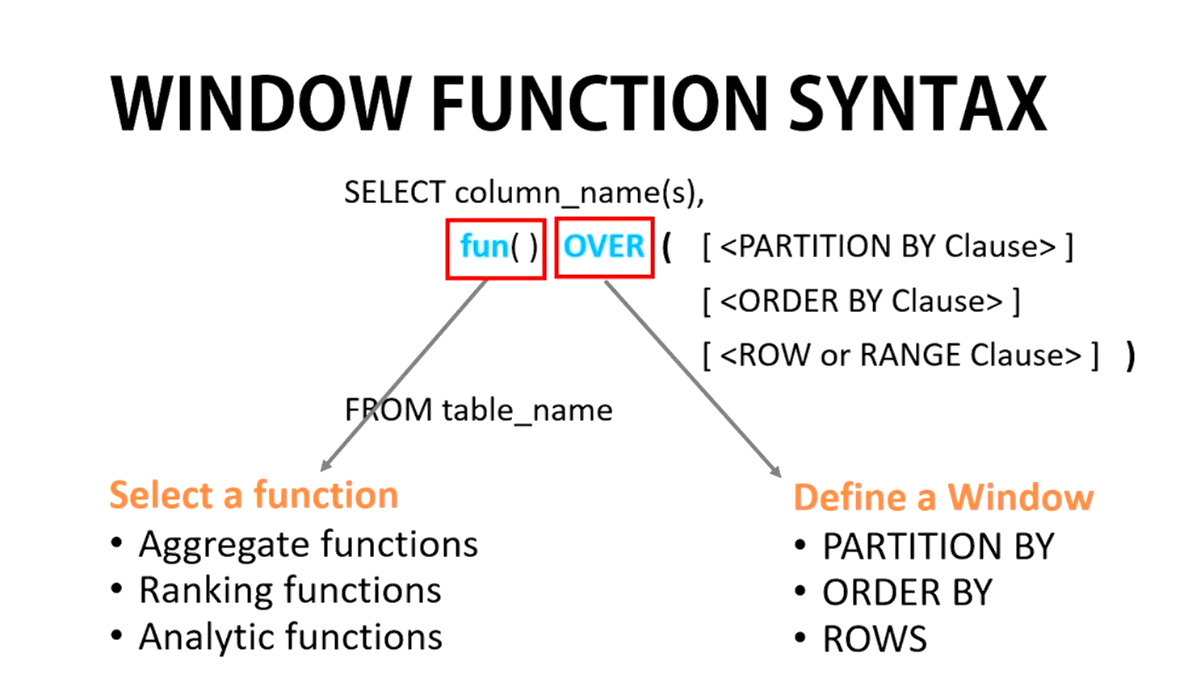

Slide 3
Windows Functions in SQL (Database Management):
In SQL, window functions are special functions that operate on a set of rows within a table, called a window. These functions allow you to perform calculations that consider not just the current row, but also other rows related to it. This is different from regular aggregate functions (like SUM or AVG) that only consider all rows in the table.
Here are some key terms related to window functions in SQL:
Window: A defined subset of rows in the table that the window function operates on.
Partition BY: This clause divides the data into groups (partitions) based on specific column values. The window function is then applied to each partition separately.
ORDER BY: This clause sorts the rows within each partition before the window function is applied.
Aggregate Window Functions: These functions perform calculations on the entire window, like SUM, AVG, MAX, MIN, etc., but with the context of the current row.
Rank Window Functions: These functions assign a rank or order to each row within the window, like RANK, DENSE_RANK, ROW_NUMBER, etc.
Value Window Functions: These functions access values from other rows within the window, like LAG, LEAD, FIRST_VALUE, etc.

Slide 4
Window Functions in Signal Processing and Statistics:
In signal processing and statistics, a window function is a mathematical function applied to a signal to modify its frequency spectrum. It's typically zero-valued outside a chosen interval and used to reduce spectral leakage when applying Fourier transforms.
Some common terms related to window functions in this context include:
Apodization function or tapering function: These are other names for window functions.
Sine window, Cosine window: These are specific types of window functions with particular shapes.

Slide 5
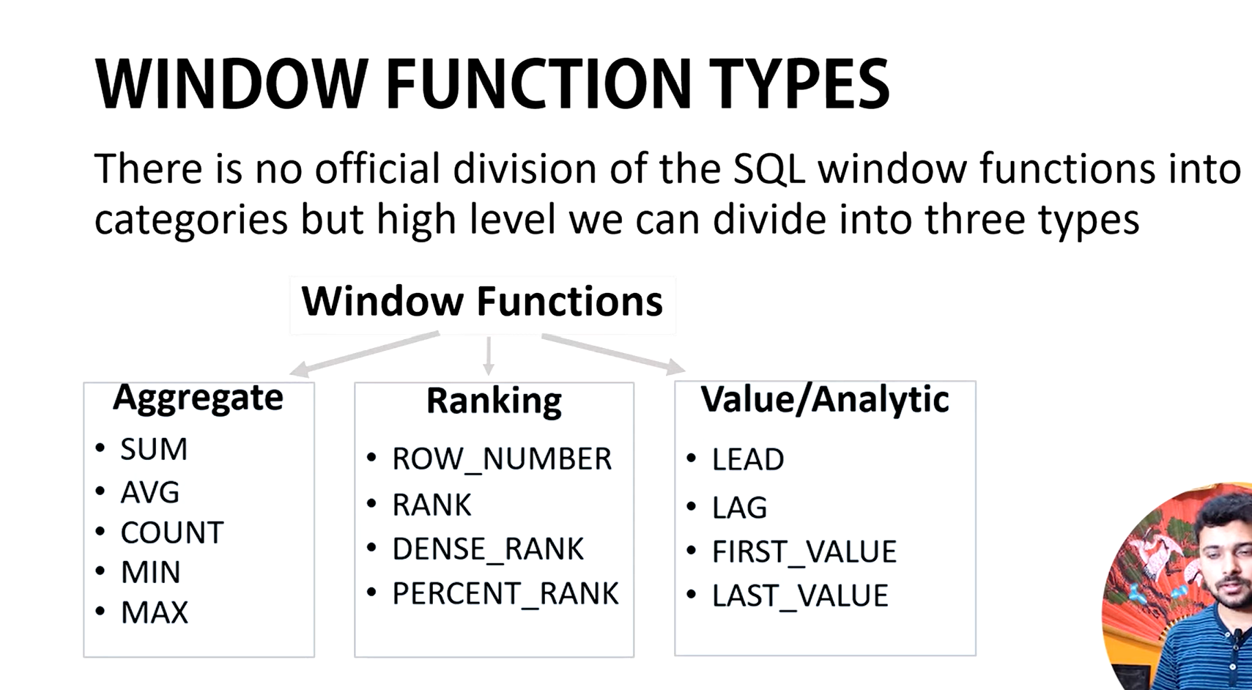

Slide 6
1. Aggregate Window Functions
These perform aggregate calculations within a defined window.
Function | Description
SUM() | Calculates the total sum of values in the window.
AVG() | Calculates the average of values in the window.
MIN() | Returns the minimum value in the window.
MAX() | Returns the maximum value in the window.
COUNT() | Counts the number of rows in the window.

Slide 7
2. Ranking Window Functions
These assign a rank or row number to each row within a window.
Function | Description
ROW_NUMBER() | Assigns a unique sequential number to each row in the window, starting from 1.
RANK() | Assigns a rank to each row, with gaps if there are ties.
DENSE_RANK() | Assigns a rank to each row, without gaps in case of ties.
NTILE(n) | Divides rows into n equal buckets and assigns a bucket number to each row.

Slide 8
3. Value Window Functions
These functions provide access to values from other rows in the window.
Function | Description
FIRST_VALUE() | Returns the first value in the window.
LAST_VALUE() | Returns the last value in the window.
LEAD(column, offset) | Returns the value of the column from the row at a specific offset after the current row.
LAG(column, offset) | Returns the value of the column from the row at a specific offset before the current row.
NTH_VALUE(column, n) | Returns the nth value in the window (e.g., 2nd, 3rd).

Slide 9
4. Statistical Window Functions
These are used for statistical calculations across the window.
Function | Description
PERCENT_RANK() | Calculates the relative rank of a row as a percentage of the total rows.
CUME_DIST() | Calculates the cumulative distribution of a value within the window.
STDDEV() | Calculates the standard deviation of values in the window.
VARIANCE() | Calculates the variance of values in the window.
CORR(expression1, expression2) | Calculates the correlation between two columns.

Slide 10
Query: Calculate the rank of employees based on their salary within each department.
  SELECT EmpID, Name, Department, Salary,
  RANK() OVER (PARTITION BY Department ORDER BY Salary DESC) AS RankInDept
  FROM Employee;
Explanation:
PARTITION BY: Groups rows by Department. Each department forms its own "window."
ORDER BY: Ranks employees within each department by Salary in descending order.
RANK(): Assigns a unique rank to each employee, with gaps if there are ties.

Slide 11
Query: Calculate SUM, AVG, MIN, and MAX of salaries for each department.
  SELECT EmpID, Name, Department, Salary,
    SUM(Salary) OVER (PARTITION BY Department) AS TotalSalary,
    AVG(Salary) OVER (PARTITION BY Department) AS AvgSalary,
    MIN(Salary) OVER (PARTITION BY Department) AS MinSalary,
    MAX(Salary) OVER (PARTITION BY Department) AS MaxSalary
  FROM Employee;

Slide 12
Query: Use ROW_NUMBER to rank employees by salary within each department.
SELECT EmpID, Name, Department, Salary, ROW_NUMBER() OVER (PARTITION BY Department ORDER BY Salary DESC) AS RowNumber FROM Employee;
Query: Use NTILE(2) to divide employees into 2 salary buckets within each department.
SELECT EmpID, Name, Department, Salary, NTILE(2) OVER (PARTITION BY Department ORDER BY Salary DESC) AS Bucket FROM Employee;
Query: Assign ranks without gaps, even if there are ties.
SELECT EmpID, Name, Department, Salary, DENSE_RANK() OVER (PARTITION BY Department ORDER BY Salary DESC) AS DenseRank FROM Employee;

Slide 13
Query: Retrieve the highest salary in each department for all rows.
SELECT EmpID, Name, Department, Salary, FIRST_VALUE(Salary) OVER (PARTITION BY Department ORDER BY Salary DESC) AS HighestSalary FROM Employee;
Query: Retrieve the lowest salary in each department for all rows.
SELECT EmpID, Name, Department, Salary, LAST_VALUE(Salary) OVER (PARTITION BY Department ORDER BY Salary ASC ROWS BETWEEN UNBOUNDED PRECEDING AND UNBOUNDED FOLLOWING) AS LowestSalary FROM Employee;
Query: Compute the percentage rank of each salary within each department.
SELECT EmpID, Name, Department, Salary, PERCENT_RANK() OVER (PARTITION BY Department ORDER BY Salary ASC) AS PercentRank FROM Employee;

Slide 14
Use ROW_NUMBER, RANK, and DENSE_RANK to rank employees by salary within each department.
SELECT EmpID, Name, Department, Salary,
ROW_NUMBER() OVER (PARTITION BY Department ORDER BY Salary DESC) AS RowNumber,
RANK() OVER (PARTITION BY Department ORDER BY Salary DESC) AS Rank,
DENSE_RANK() OVER (PARTITION BY Department ORDER BY Salary DESC) AS DenseRank
FROM Employee;

Slide 15
Query: Calculate a cumulative total of salaries within each department.
SELECT EmpID, Name, Department, Salary,
SUM(Salary) OVER (PARTITION BY Department ORDER BY Salary) AS RunningTotal
FROM Employee;

Slide 16
Query: Get the first, last, next (LEAD), and previous (LAG) salary within each department.
SELECT EmpID, Name, Department, Salary,
FIRST_VALUE(Salary) OVER (PARTITION BY Department ORDER BY Salary DESC) AS FirstSalary,
LAST_VALUE(Salary) OVER (PARTITION BY Department ORDER BY Salary DESC
ROWS BETWEEN UNBOUNDED PRECEDING AND UNBOUNDED FOLLOWING) AS LastSalary,
LEAD(Salary) OVER (PARTITION BY Department ORDER BY Salary DESC) AS NextSalary,
LAG(Salary) OVER (PARTITION BY Department ORDER BY Salary DESC) AS PrevSalary FROM Employee;

Slide 17
-- END--

